Slide 1

Susquehanna Workforce Innovation Partnership
Quarterly Meeting
February 13, 2018
Notes:
We like to use our introductions to get to know each other. Last time we had you introduce yourself with the best job you ever had early in your career. This time we ask … What are you most excited about regarding your job or program right now? What's one work-related skill that you'd like to develop and why?

Slide 2
Labor Market Update
Linda Siegel
Susquehanna Workforce Network

Slide 3
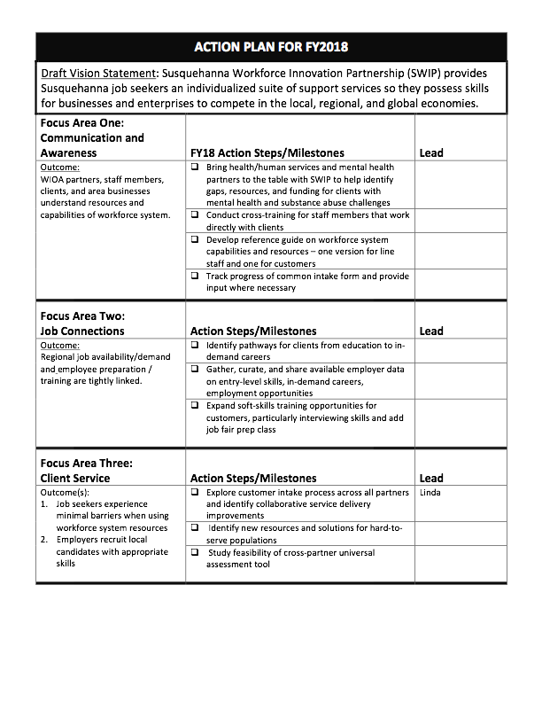
Q1 Recap
July: Interviews with WIOA partners about vision, challenges, opportunities under WIOA structure. Three goals emerged.
August: Quarterly meeting discussion on vision, barriers, and solutions resulted in the Action Plan for FY18. Focus Area subcommittees formed.
September/October: Focus Area subcommittees worked on Action Plan steps via conference calls.
Notes:
Looking back at Quarter 1: Interviews, meeting, Action plan, focus area subcommittees.
In a very short amount of time, we identified and agreed upon challenges and opportunities in our region for job seekers. We then agreed on a roadmap for the year.

Slide 4
Q2 Recap
October: Focus Area groups worked on action plan via conference calls
November: Quarterly meeting discussion on substance abuse, addiction, and mental health resources in Harford and Cecil Counties. Joe Ryan from Harford County Office of Drug Control, Don Mathis, Addiction Connections, Tracy Kelly, Core Service Agency of Harford County, and Chris Martin, Advantage Psychiatric Services.
December/January: Job Connections team worked with Cecil to develop model pathway
Notes:
Looking back at Quarter 2: Focus group activity, Quarterly meeting focused on substance abuse and mental health resources. Developed model pathway.

Slide 5

How are we doing?
Vision: A seamless workforce system that strengthens individuals, employers, businesses, and communities in the Susquehanna region and beyond
Mission: Susquehanna Workforce Innovation Partnership provides Susquehanna job seekers an individualized suite of support services so they possess skills for businesses and enterprises to compete in the local, regional, and global economies.
Notes:
Clearly this is a lofty goal and a vision that we will always be striving toward. But have we made progress? From your vantage point, have we tightened the seams in our workforce system? Do we have examples of where we are working together better?
Second question – what metrics will tell us whether we are making progress?

Slide 6
Action Plan Progress
Focus Area 1: Communications
  Bring substance abuse/mental health organizations to table
  Additional cross-training for customer-facing staff
  Reference guide
  Status of state common intake form
WIOA partners, staff members, clients, and area businesses understand resources and capabilities of workforce system.
Notes:
WIOA partners, staff members, clients, and area businesses understand resources and capabilities of workforce system.
Focus Area 1 has done a great job identifying common topics of interest to our group and making it part of our meetings
Has identified the need for additional cross-training
Working on the reference guide

Slide 7
Action Plan Progress
Focus Area 2: Job connections
  Identify pathways from education to in-demand careers
  Gather, curate, and share available employer data on entry-level skills, in-demand careers, and employment opportunities
  Expand soft-skills training opportunities for customers, particularly interviewing skills and job fair prep
Regional job availability/demand and employee preparation and training are tightly linked.
Notes:
Regional job availability/demand and employee preparation and training are tightly linked.
Have been working on backward mapping career pathways.
Conducting a survey of existing assessment tools.

Slide 8
Action Plan Progress
Focus Area 3: Client Service
  Explore customer intake process across all partners and identify collaborative service delivery improvements
  Identify new resources and solutions for hard-to-serve populations
  Study feasibility of cross-partner universal assessment tool
Job seekers experience minimal barriers when using workforce system resources
Employers recruit local candidates with appropriate skills
Notes:
Job seekers experience minimal barriers when using workforce system resources
Employers recruit local candidates with appropriate skills
Exploring state common assessment tool and who that will benefit.
Looking at assessment tools that each partner is using. Also will explore common referral tool — to ensure a “warm” handoff.

Slide 9

Small Group Work Sessions
End at 3:00 p.m. and return to Training Room
Group 1: Communications and Awareness (Cluster 1 Room)
Group 2: Job Connections (Training Room)
Group 3: Client Service (Chesapeake Conference Room)

Slide 10

Today’s Discussion
Panel Discussion: Serving Justice-Involved Clients
  Sheryl Davis Kohl, Beacon Staffing
  Elizabeth Rowe, Northeastern Maryland Legal Aid Bureau

Slide 11

Q3/Q4 Next Steps
WIOA MOU discussions
RSA Executive Session
Action Plan progress
Quarterly Meeting:
May 8, 2018, 2-4 p.m.
Special Topic?
Notes:
We are going to be working with you to evaluate progress on work identified in MOU. I’ll be calling/emailing in next two weeks.
Setting up an RSA executive session of one rep from each core partner
Next quarterly meeting on May 8
Special topic? Housing? Homelessness?

