Slide 1

Susquehanna Workforce Innovation Partnership
Quarterly Meeting
May 8, 2018
Notes:
What’s something you want to do in the next year that you’ve never done before?

Slide 2
Introductions
What’s something you want to do in the next year that you’ve never done before?

Slide 3
2:10 Presentation: State Benchmarks Initiative
LiLi Taylor, Senior Policy Analyst, DLLR
2:40 Discussion: Reviewing SWIP’s FY2018 Progress and FY2019 Plans
3:15 Barriers to Employment Discussion Series (Part 3): Housing Resources
    Lenora Robinson, Harford County Office of Community and Economic Development
    Colandra Coleman, Meeting Ground, Cecil County
3:50 Regroup and Q4 Next Steps
4:00 Adjourn

Slide 4
FY2018
Progress
✔️
✔️
✔️

Slide 5
Soft Skills In Demand
Advertised Soft Skill | SWN | Cecil DSS | Harford DSS | DORS | HCC | Cecil College
Customer service
Problem solving
Interpersonal skills
Decision making
Risk management
Flexibility
Time management
Mentoring
(Susquehanna Labor Market Fact Sheet)

Slide 6
Other Common Soft Skills In Demand
Soft Skill | SWN | Cecil DSS | Harford DSS | DORS | HCC | Cecil College
Emotional Intelligence
Work Ethic
Teamwork
Coachability
Communication Skills
Just about everyone also provides some form of job acquisition training (resume prep, interview skills, etc.)

Slide 7
FY2018
Progress
✔️
✔️
✔️
✔️
✔️

Slide 8
State and Local Goals
Strategic Goal 1: Increase earning capacity of Maryland’s workforce system customers by maximizing access to employment
Strategic Goal 2: Increase earning capacity of Maryland’s workforce system customers by maximizing access to and use of skills and credentialing
Strategic Goal 3: Increase earning capacity of Maryland’s workforce system customers by maximizing access to and use of life management skills
Strategic Goal 4: Increase earning capacity of Maryland’s workforce system customers by eliminating barriers to employment
Strategic Goal 5: Strengthen and enhance the effectiveness and efficiency of Maryland’s workforce system

Slide 9
2019 SWIP Action Plan

Slide 10
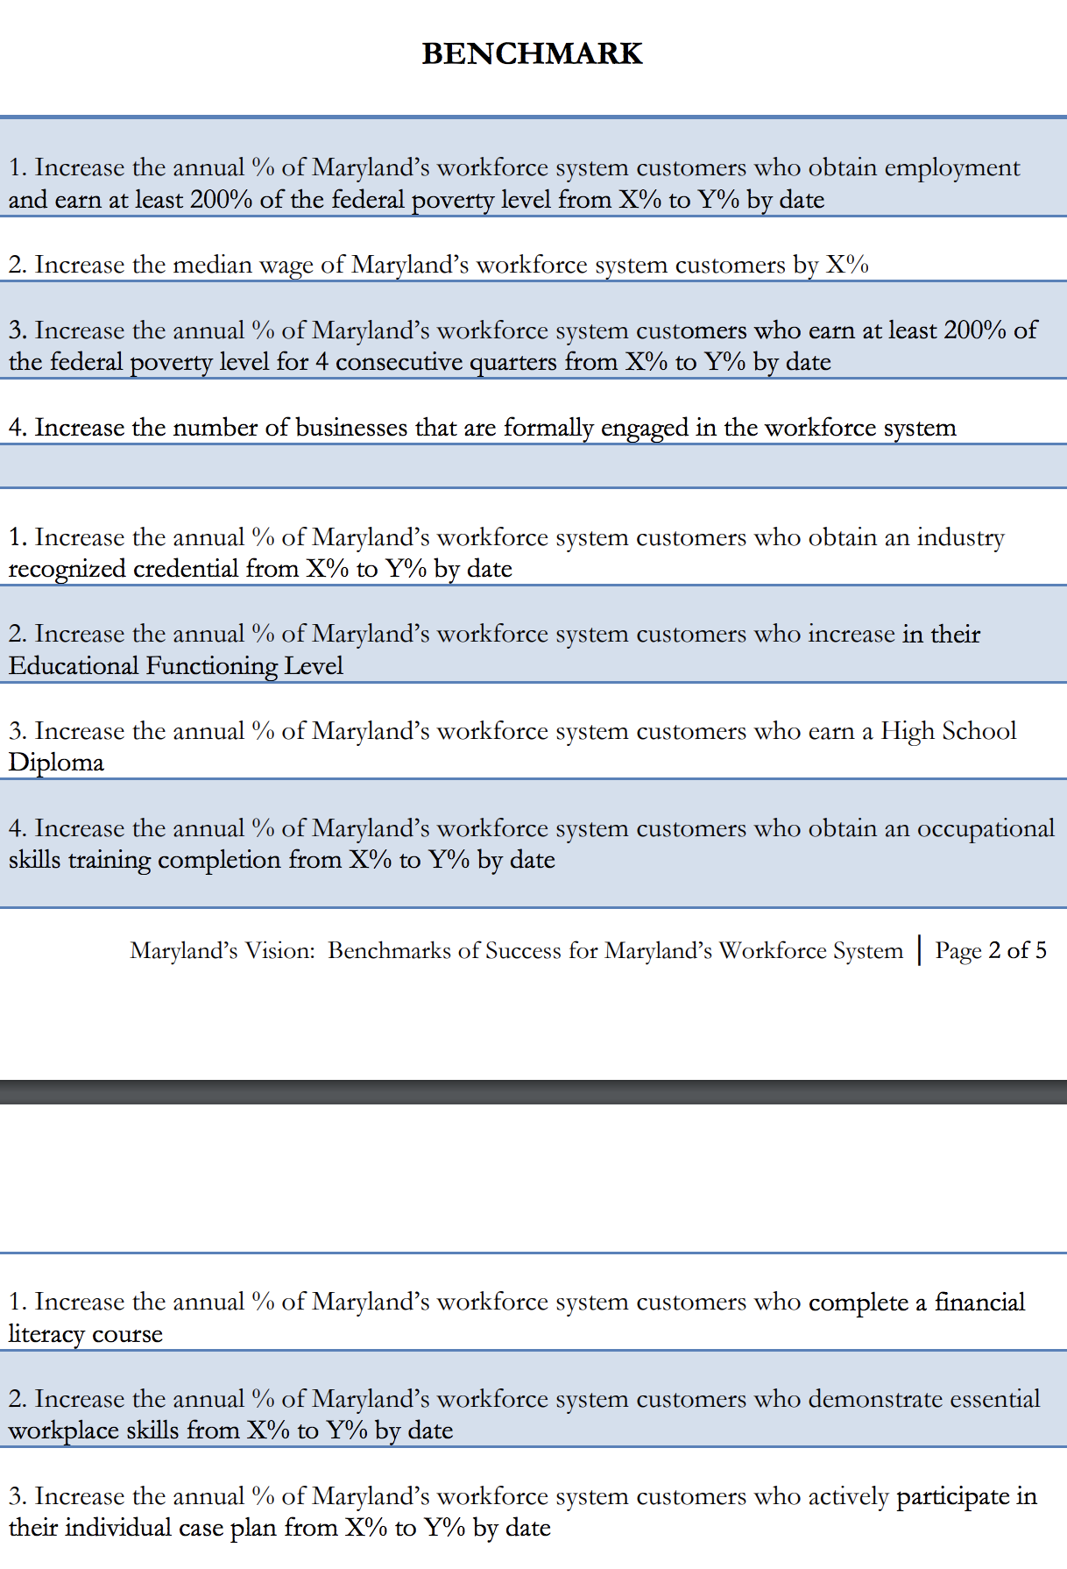
Benchmark Baseline

Slide 11

Today’s Discussion
Barriers to Employment Discussion: Homeless Resources in Harford and Cecil Counties
  Lenora Robinson, Harford County Community and Economic Development
  Colandra Coleman, Meeting Ground, Cecil County

Slide 12

FY2018 SWIP Operator’s Actions
Complete a Resource Directory that includes information from this year’s quarterly meetings
End-of-year MOU evaluation
Benchmark baseline
WIOA Partner Survey
Final Report – FY2018
Preparations for Quarterly Meetings:
- August 8, 2018
- November 14, 2018
- February 13, 2019
- May 8, 2019
Notes:
Completing the resource directory to include info and contacts from this year’s meetings
Compile information collected throughout year and post/share via wioapartners.com
Series of interviews with partners – evaluate MOU progress, conduct baseline benchmark assessment, gather feedback from partners as to this year’s program and progress, compile a final report to share with WIB

