Slide 1

Susquehanna Workforce Innovation Partnership
Quarterly Meeting
November 13, 2018
Quarterly Meeting
May 8, 2018

Slide 2
Agenda
2:00 Introductions and Update
“What is the best career or life advice you’ve ever gotten”
2:10 Harford Community College WIOA Update
2:15 Molly Dugan, MD DLLR, GED and the National External Diploma Program
2:20 Discussion Topic: Transportation Resources and Programs
2:50 Goals and action plan for FY2019
3:10 Small Groups
3:40 Reconvene and wrap up
4:00 Adjourn

Slide 3
Transportation in Susquehanna Region: Programs, Plans, and Resources
Dave Trolio, director of Community Services, Cecil County
Suzanne Kalmbacher, chief of Cecil Transit
Steve Overbay, deputy director of Harford County Office of Community and Economic Development
Gary Blazinsky, transit administrator for Harford County

Slide 4
Vision and Mission
WIOA Vision: Increased access and opportunities to employment, education, training, and support services.
SWIP Mission: Susquehanna Workforce Innovation Partnership provides Susquehanna job seekers an individualized and seamless suite of support services so they possess skills for businesses and enterprises to compete in the local, regional, and global economies.

Slide 5
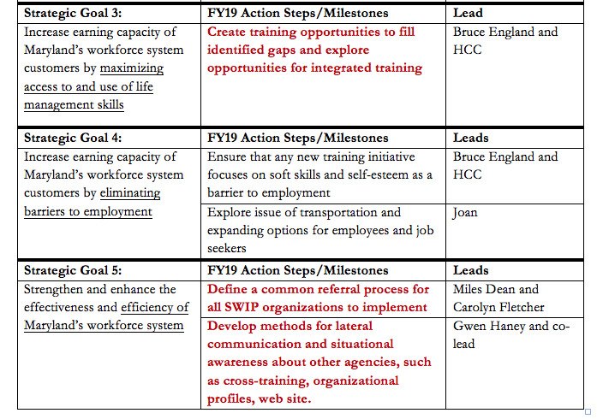
Action Plan mapped to state benchmarks.

Slide 6
Career Pathways
FY19 Career Pathway Goals (as taken from the Susquehanna Labor Market Fact Sheet):
  Manufacturing
  Construction
  IT
  Logistics
Baltimore Metro Council produced a format for career pathways that we have adopted for ours

Slide 7
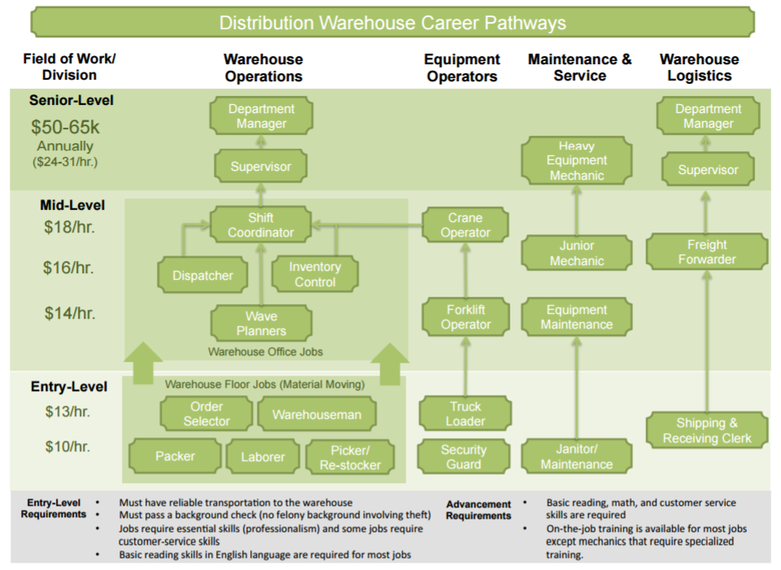

Slide 8
Health Care Career Pathways (Through Partner Providers Cecil College and Harford Community College)
Healthcare Career Pathways
Field of Work/ Division
Medical Therapeutics
Health Informatics
Rehabilitation Services
Dental Hygienist
Registered Nurse (BS)
Senior-Level
Medical/Health Service Manager
Physical Therapist
Occupational Therapist
$75k-105k
Nurse Practitioner
Registered Nurse
Mid-Level
Paramedic
Medical Assisting
Licensed Practical Nurse
Medical Insurance Billing
Health Information Technologist
$36k-60k
Personal Trainer
Physical Therapist Assistant
Emergency Medical Technician
Dental Assistant
Phlebotomist
Medical Admin Assistant
Physician Professional Coder
Entry Level
Pharmacy Technician
Certified Medicine Aide
$25k-35k
Physical Therapy Technician
Certified Medical Assistant
Certified Nursing Assistant
Zone I Careers
Zone 2 Careers
Zone 3 Careers
Zone 4 Careers

Slide 9
Health Care Career Pathways (Through Partner Providers Cecil College and Harford Community College)
Manufacturing Career Pathways
Field of Work/ Division
Production
Engineering
Maintenance
Engineering Manager
Senior-Level
General Manager
Maintenance Manager
$66k-105k
Engineer
Mid-Level
CNC Programmer
First Line Supervisor
$36k-60k
CAD Designer
Industrial Machinery Mechanic
CNC Operator
QC Technician
Entry Level
Manufacturing Technician
Production/ Planning/ Expediting Clerk
Machinist
$25k-35k
Engineering Technician
Maintenance Mechanic
Welder
Machine Operator
Zone I Careers
Zone 2 Careers
Zone 3 Careers
Zone 4 Careers

Slide 10
Soft Skills Training
FY19 Soft Skills Goals:
  Assess baseline data for opportunities to integrate common training
  Assess gaps to determine what new training should be offered
Today’s small group will discuss an opportunity to help identify client strengths, blind spots and self esteem levels

Slide 11
Common Referral Practice
Review existing referral forms
Observe other jurisdictions’ processes
Overcome obstacles

Slide 12

Communications
Optimizing website for information sharing
Content guidelines for monthly email
Calendar of events

Slide 13
Small Groups
Create training opportunities: Room 126
Define a common referral process: Room 202B (here)
Communication: Room 228

Slide 14
Quarterly Meetings for FY2019
February 12, 2019: Elkton Job Center
May 14, 2019: Havre de Grace Groundfloor
Slide 14

