Slide 1

Susquehanna Workforce Innovation Partnership (SWIP)
Quarterly Meeting
January 20, 2021

Slide 2

Agenda
1:00 Introductions
    Starting tomorrow, there are 25 hours in a day. How will you use that extra hour?
1:10 Partner Updates: SWN, DORS, SSA-I, Cecil College, HCC, Cecil DSS, Harford DSS, DLLR, Housing, HCAA
        Operations updates
        Changes in people, process, program, or place of interest to other partners
1:20 SWIP Job shadowing program
1:35 Leisure and hospitality career pathway
1:50 SWN Board Employment Blueprint
2:00 Customer Service Focus Group

Slide 3

Today’s Goals
Determine participation in proposed job shadowing program
Assess value of hospitality career pathway
Review SWN Employment Blueprint plan and initiatives
Identify customer service practices across partner organizations

Slide 4
SWIP Shadowing Program - Concept
Current Situation: There is evidence that employees of WIOA partner organizations need additional exposure to partner capabilities to realize the goals of the WIOA – providing a seamless suite of services to workforce center customers.
Concept: Implement a SWIP employee shadowing program
Discussion: Shadowing programs and extended details are well-established methods for creating strong intra-organization networks and enhancing collaborative efforts. Shadowing allows employees to ‘walk a mile in their partners’ shoes.’ They learn the priorities, processes and day to day challenges their partners face, and develop stronger channels of communication and collaboration.

Slide 5
SWIP Shadowing Program - Implementation
Establish clear program goals
Develop a list of processes and personnel who would most benefit from shadowing opportunities
Create a limited pilot program with the highest priority individuals (Job Centers?)
  Create schedule of monthly shadowing opportunities
  Plan specific activities for the shadowing period to enhance organizational collaboration and communication and increase Workforce Center effectiveness
  Conduct pilot and evaluate results
Refine and improve the program and extend to remaining prioritized personnel over the course of X months

Slide 6
SWIP Shadowing Program - Outcomes
Workforce Centers deliver a better customer experience
SWIP organizations develop a deeper collaborative network that better addresses customer problems
Increased awareness of partner capabilities
Better interpersonal relationships amongst SWIP organization staff
DISCUSSION

Slide 7
Hospitality Career Pathways
Field of Work/ Division
Restaurants/Food and Beverage
Lodging
Travel and Tourism
Recreation and Attractions
Senior-Level
Food Service Manager
Lodging Manager
Gambling Manager
$60k-92k
First Line Supervisor
Mid-Level
Cook, Private
Chef/ Head Cook
Travel Agent
Recreation Worker
$37k-54k
First Line Supervisor
Gambling Cage Worker
Entry Level
Concierge
Tour Guide
$21k-35k
Bartender
Desk Clerk
Amusement/ Recreation Attendant
Host/ Hostess
Cooks
Baker
Usher/ Ticket Taker
Travel Guide
Barista
Waitstaff
Dishwasher
Janitor/ Cleaner
Ticket Agent
Animal Trainer
Cafeteria Attendant
Fast Food Worker
Maid/ Housekeeper
Gambling Dealer
Food Prep Worker
Zone 0 Careers
Zone I Careers
Zone 2 Careers
Zone 3 Careers
Zone 4 Careers

Slide 8
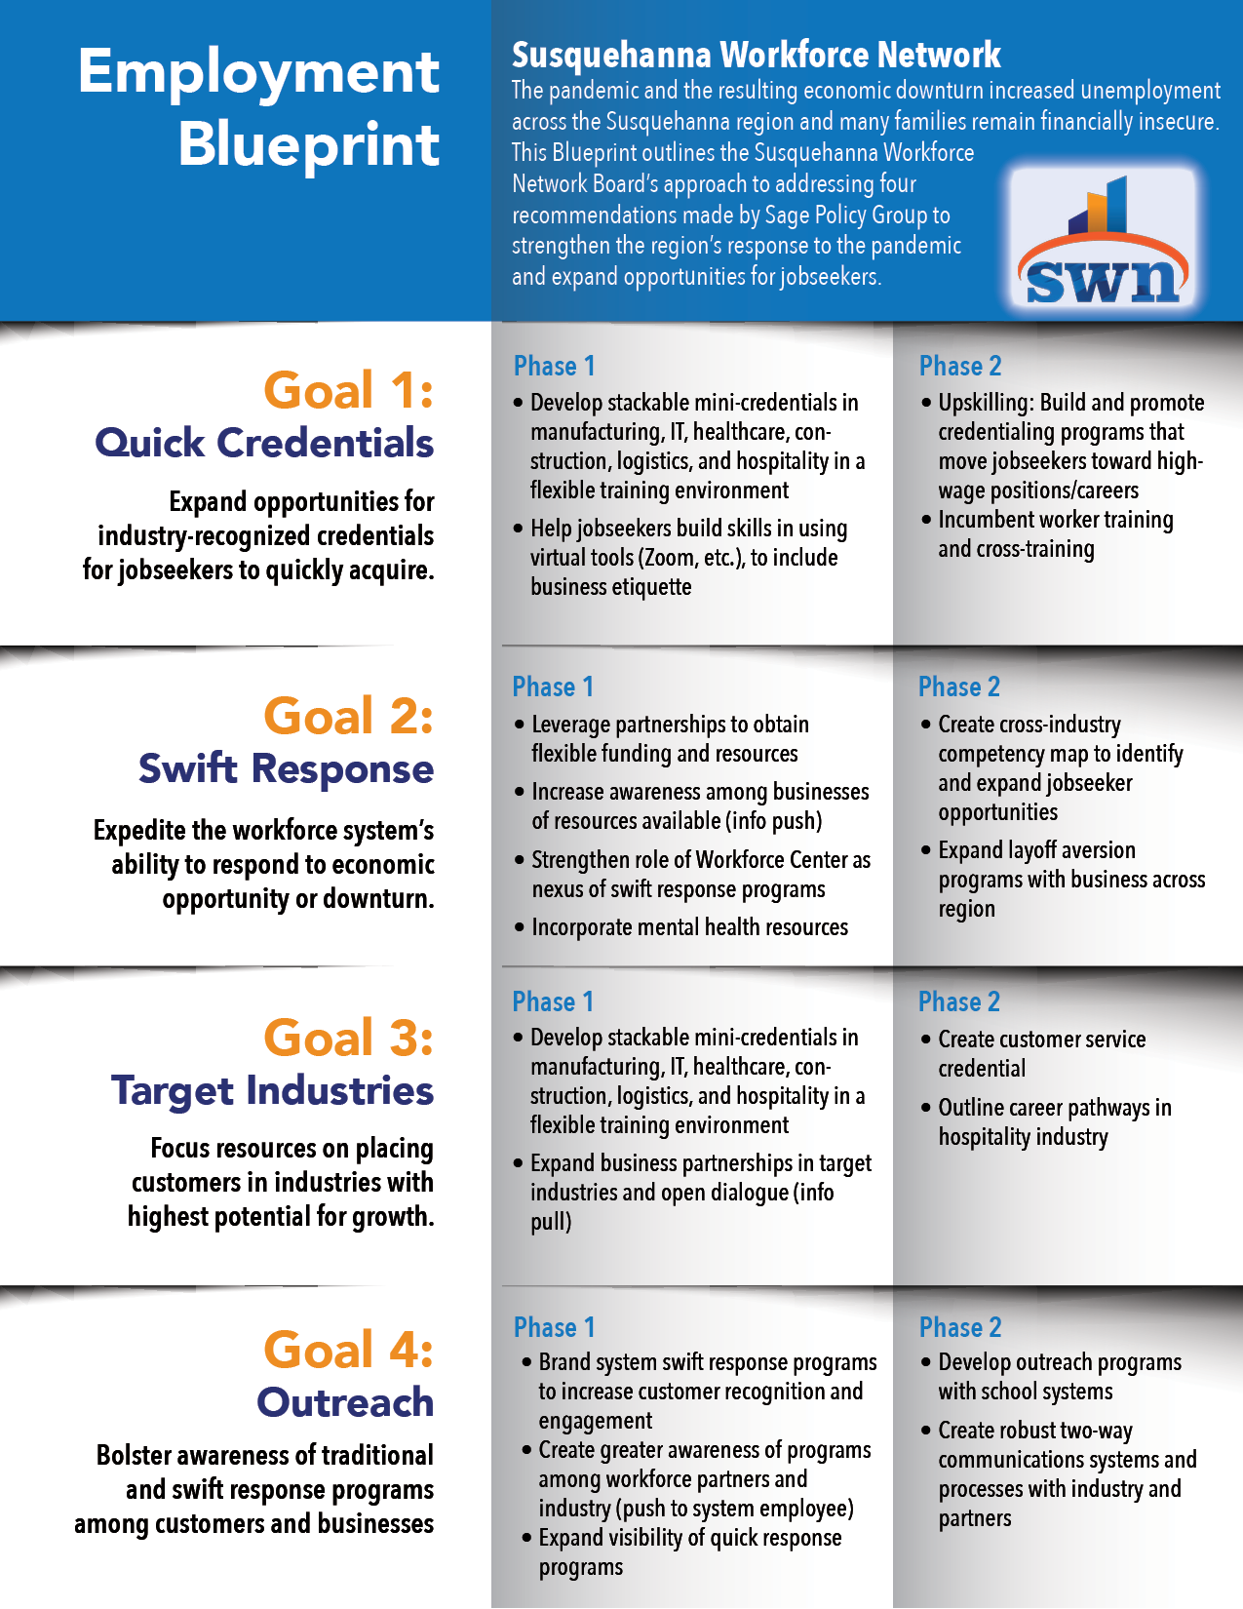
Plan to implement Sage Policy Group Labor Market Recommendations

Slide 9
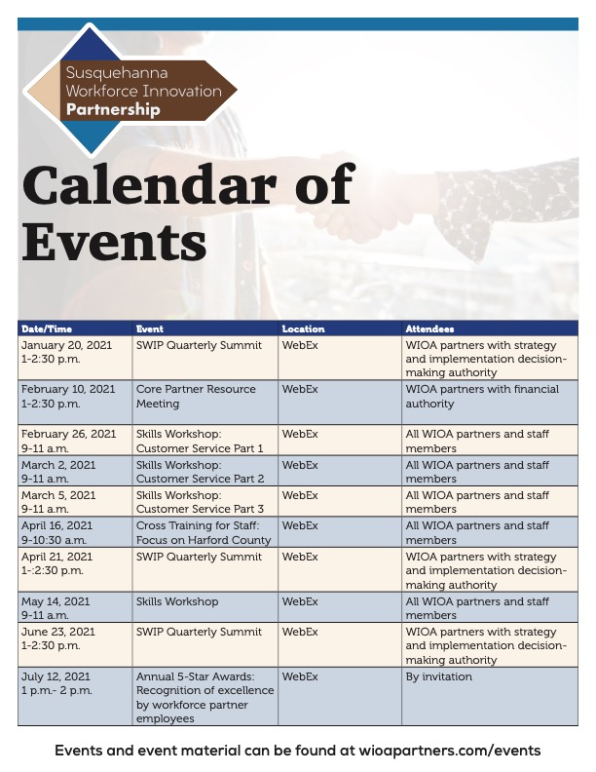
2021 Calendar of Events

